Slide 1

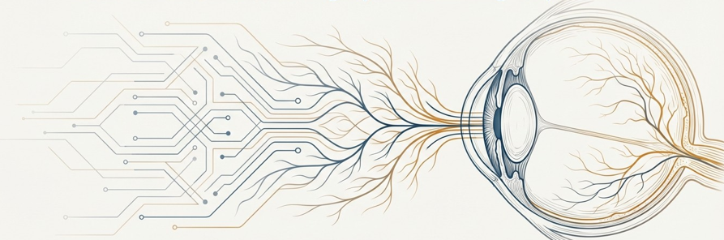
Diabetic Retinopathy Detection Using Retinal Images
A Deep Learning Approach with Advanced Preprocessing
Elif Karapınar, Elif Keleş, Zehra Nur Demir
Gebze Technical University, Computer Engineering

Slide 2

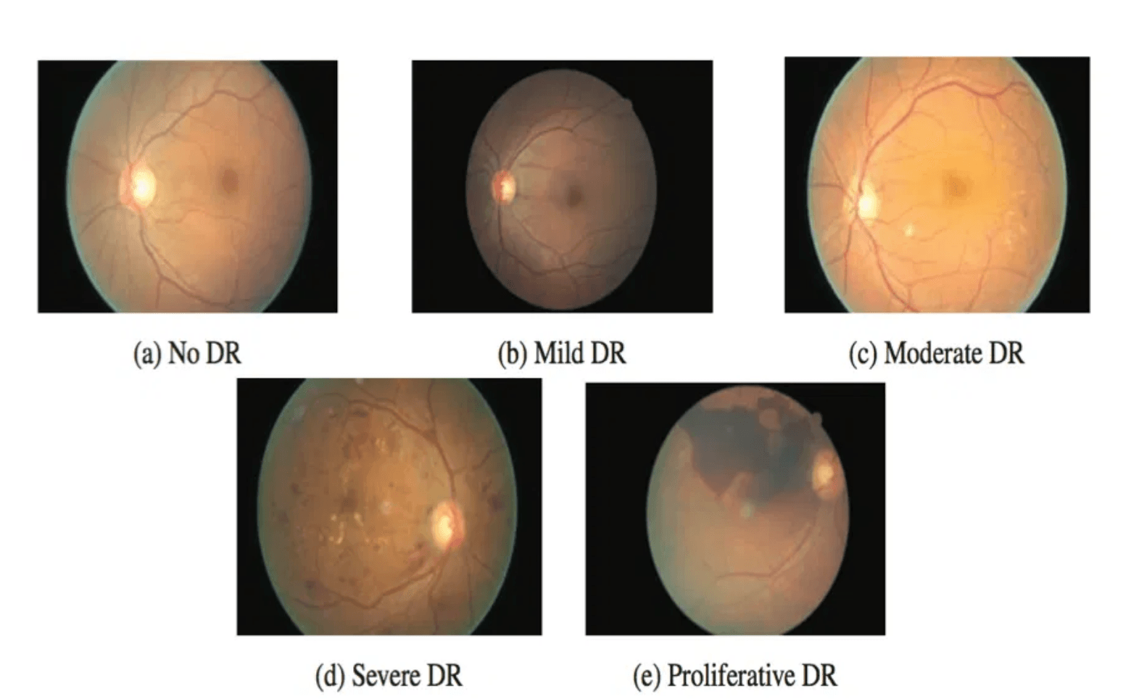
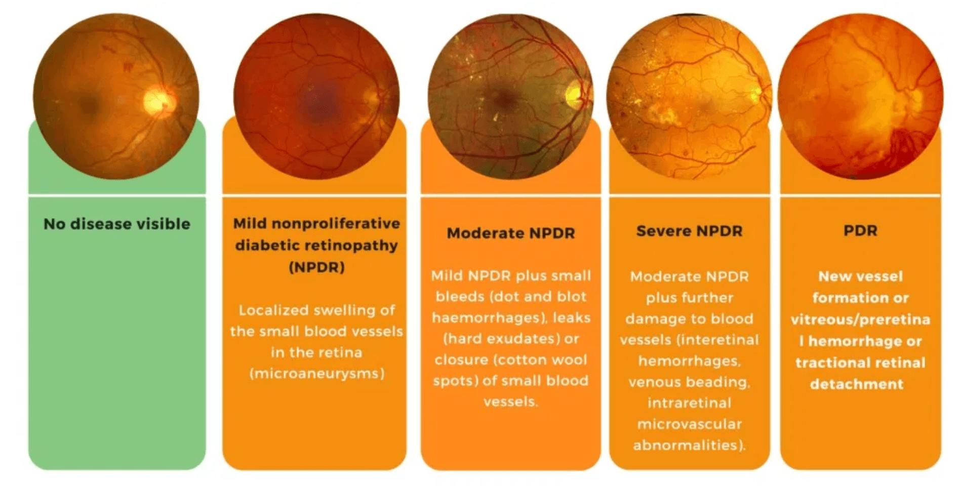
DR Severity Progresses Through Five Clinical Stages
Grade 0: No DR
Normal retinal vasculature; no visible abnormalities or lesions.
Grade 1: Mild DR
Earliest detectable signs; presence of small microaneurysms.
Grade 2: Moderate DR
Increased vascular abnormalities, hemorrhages, and cotton wool spots.
Grade 3: Severe DR
Clinical progression from healthy retina to advanced Proliferative DR
Extensive hemorrhages and venous beading indicating significant ischemia.
Grade 4: Proliferative DR
Abnormal neovascularization; high risk of vitreous hemorrhage and blindness.
Visual markers of retinal vascular damage

Slide 3

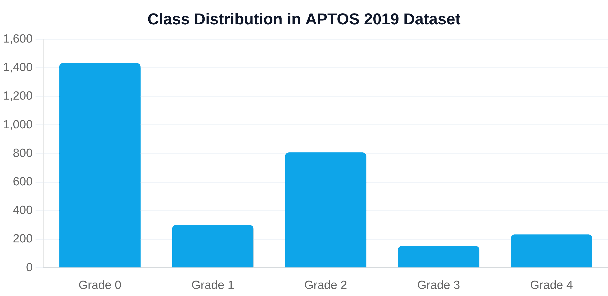
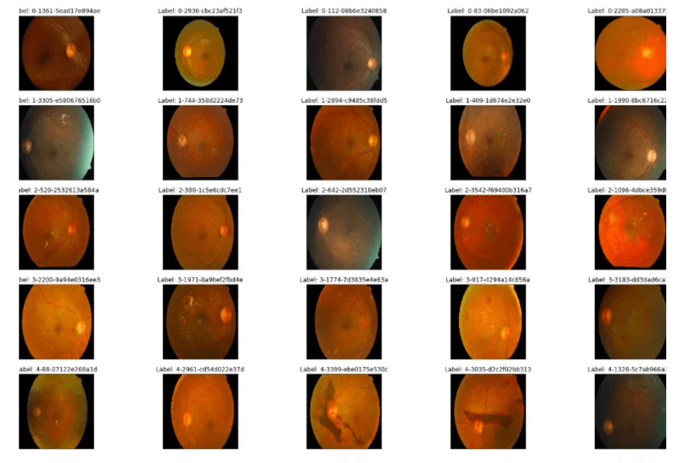
APTOS 2019 Dataset Presents Real-World Class Imbalance
DR Severity Grade
Clinical Diagnosis
Image Count
Grade 0
No DR
1434
Imbalance Mitigation Strategy
Grade 1
Mild DR
300
Balanced class weighting was implemented to ensure that under-represented severity classes contribute more strongly to the training loss.
Grade 2
Moderate DR
808
Grade 3
Severe DR
154
Grade 4
Proliferative DR
234

Slide 4

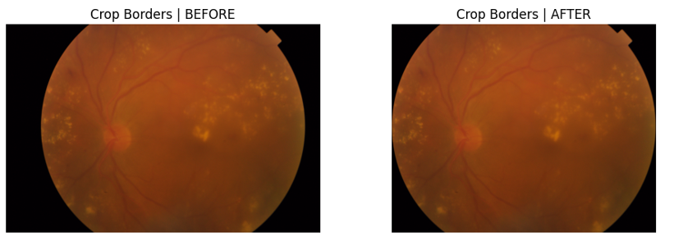
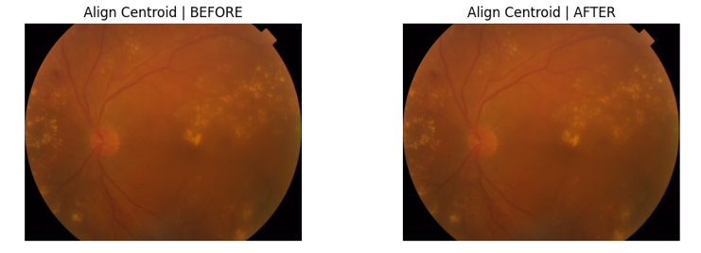
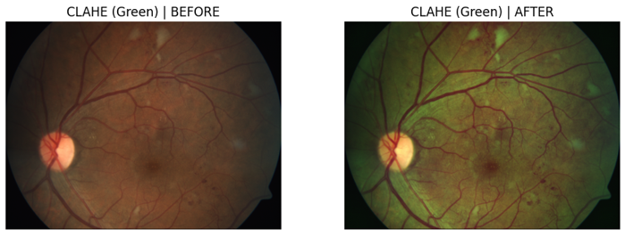
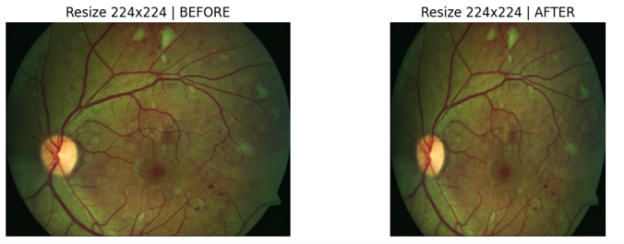
Standardized Preprocessing Pipeline Improves Image Quality
01
02
03
04
Threshold-Based Cropping
Spatial Alignment
CLAHE Enhancement
Input Standardization
Removes non-informative black borders surrounding the retinal region to focus computational resources on relevant tissue.
Utilizes intensity-based centroid estimation to center the retinal region, ensuring spatial consistency across the dataset.
Applied to the green channel to maximize contrast of vascular structures and highlight subtle pathological lesions.
Final resizing to 224x224 pixels and normalization to match ImageNet statistics for efficient transfer learning.
This multi-stage pipeline reduces background noise and enhances diagnostically critical features, providing a robust foundation for high-accuracy deep learning classification.

Slide 5
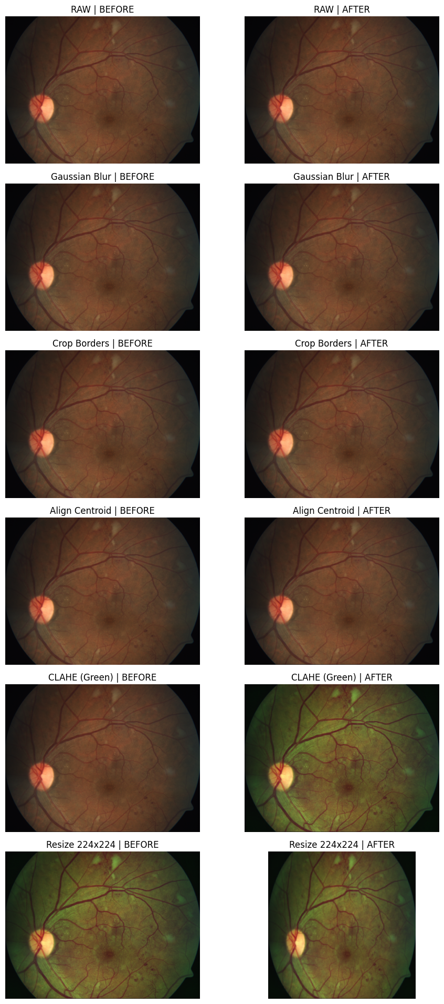
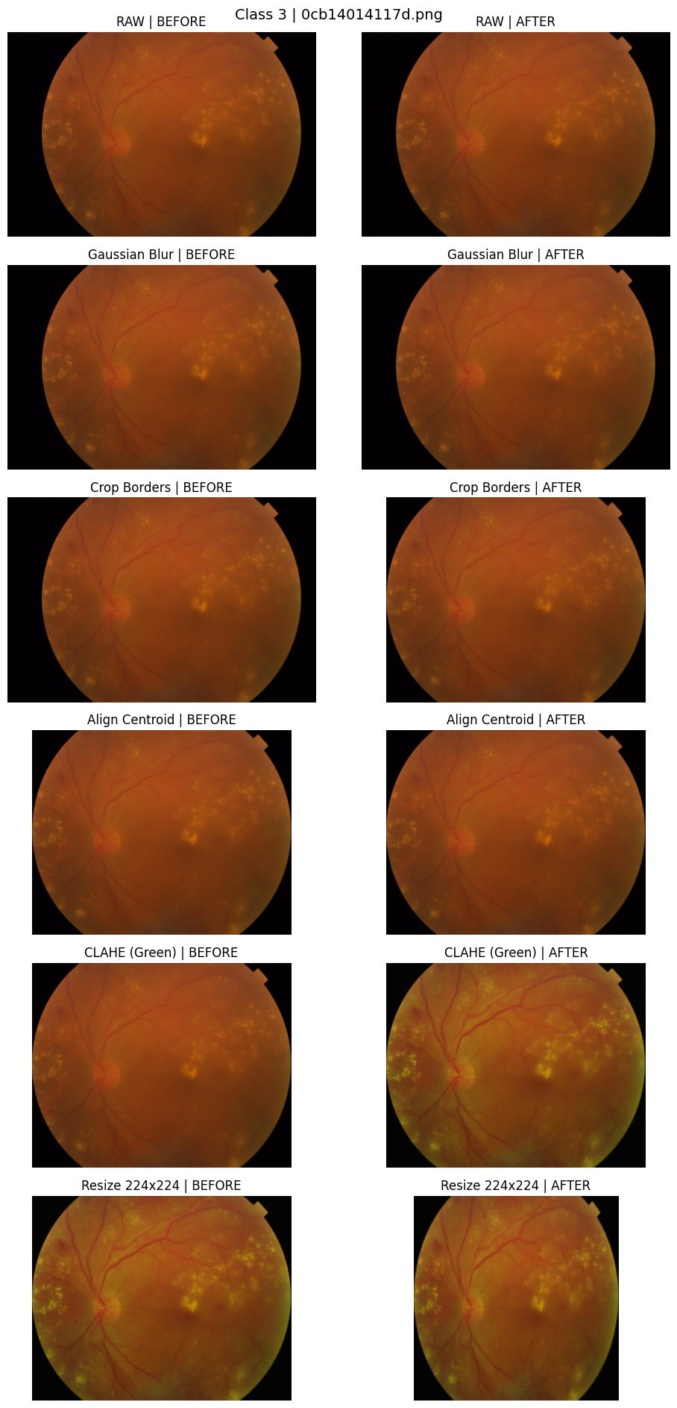

Slide 6

Threshold-Based Cropping Removes Non-Informative Black Borders
The Challenge
Raw retinal fundus images often contain significant black borders that occupy a large portion of the frame. These regions consume computational resources and introduce unnecessary background noise without providing any diagnostic information.
Technical Implementation
Intensity-based thresholding is applied to identify the boundaries of the circular retinal region.
The algorithm automatically calculates the bounding box that encapsulates the active retinal area.
Non-informative pixels outside this bounding box are discarded, isolating the ROI (Region of Interest).
"By isolating the retinal region, we ensure that the model's feature extraction is focused entirely on pathological markers, preventing distortion during subsequent resizing steps."

Slide 7
Spatial Alignment and Centering Ensure Input Consistency
01
02
03
Method
Action
Benefit
Intensity-based centroid estimation is employed to precisely locate the geometric center of the retinal region, accounting for variations in initial image capture.
Images are spatially aligned by centering the identified retinal region within the standardized frame, ensuring a uniform coordinate system across the entire dataset.
Consistent positioning of anatomical landmarks like the optic nerve and macula allows the CNN to learn spatial features more effectively, reducing model variance.
"Standardizing the spatial orientation of retinal structures is a critical prerequisite for stable model convergence and high diagnostic reliability."

Slide 8

CLAHE on Green Channel Maximizes Vascular Contrast
Adaptive Enhancement
Green Channel Selection
Clinical Significance
Contrast Limited Adaptive Histogram Equalization (CLAHE) is employed to overcome global lighting inconsistencies.
Enhanced feature visibility directly impacts the model's ability to distinguish between subtle DR grades.
The Green Channel is isolated as the primary input for the detection model.
→
Provides the highest contrast between blood vessels and the retinal background.
→
Sharpens the edges of
→
Operates on small local regions (tiles) rather than the entire image.
microaneurysms
for easier detection.
→
Red Channel is often over-saturated in fundus photography.
→
Improves the visibility of fine vascular structures and hemorrhages.
→
Limits contrast amplification to prevent noise over-enhancement.
→
Blue Channel typically contains high levels of noise and low signal.
→
Reduces inter-class confusion between Mild and Moderate stages.
→
Ensures uniform visibility across both central and peripheral retinal areas.

Slide 9
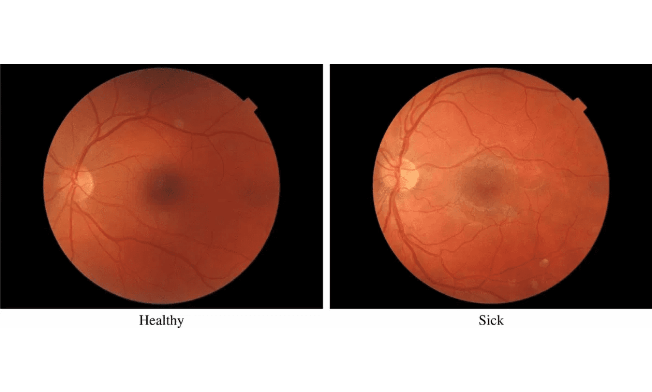
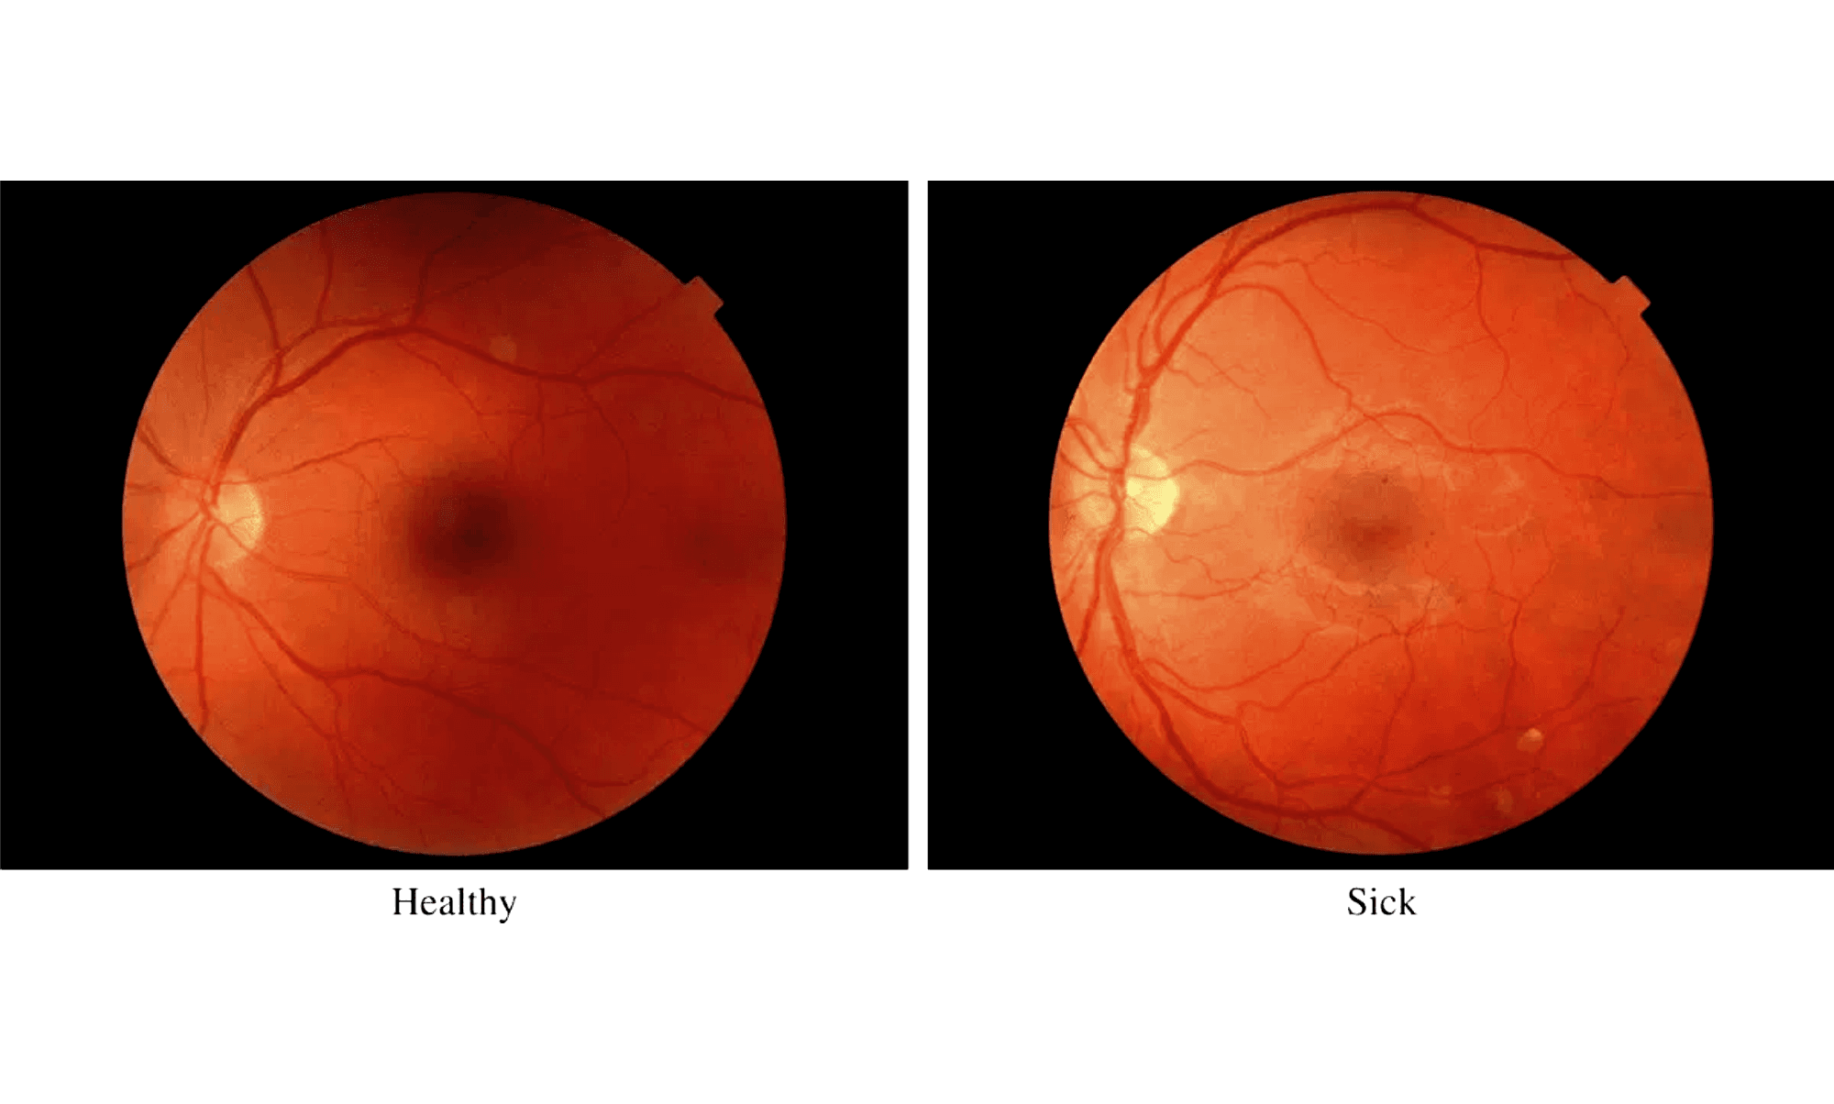






Preprocessing Comparison: Before and After Enhancement
Raw Fundus Image
Enhanced Output
Non-informative black borders
Threshold-based border removal
Low contrast and dim lighting
CLAHE-enhanced vascular contrast
Inconsistent spatial alignment
Standardized 224x224 resolution
Visual Impact: The transformation isolates the retinal tissue and highlights pathological features like microaneurysms and exudates, providing the foundation for high-accuracy deep learning classification.

Slide 10

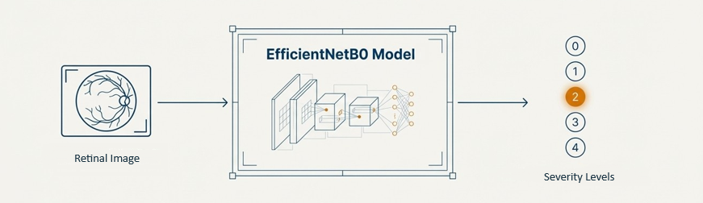
EfficientNetB0 Architecture Optimizes Accuracy and Efficiency
EfficientNetB0 Backbone
Global Average Pooling
Dropout Layer (0.3)
Softmax Output Layer
ImageNet-Pretrained Feature Extractor
Spatial Dimension Reduction
Overfitting Mitigation
5-Class DR Severity Probabilities
Feature Extraction
Classification Head
Efficiency Focus
Leverages compound scaling to balance depth, width, and resolution, providing superior feature representations for medical imaging.
Custom-designed head replaces the original ImageNet classifier to adapt the model for the specific 5-level ordinal DR grading task.
EfficientNetB0 offers a favorable accuracy-to-parameter ratio, enabling high performance with lower computational overhead.

Slide 11
Two-Stage Transfer Learning Strategy Drives Convergence
Phase I: Warm-up
Phase II: Fine-tuning
Initial Feature Adaptation
Global Network Optimization
Backbone Status
Backbone Status
Frozen (EfficientNetB0 weights locked)
Unfrozen (All layers trainable)
Learning Rate
Learning Rate
1 × 10⁻³ (High for rapid head adaptation)
1 × 10⁻⁴ (Low for stable weight updates)
Duration
Duration
Initial 3 Epochs
Until Convergence (Restored at Epoch 5)
Objective
Objective
Train the classification head to interpret pretrained features for DR severity levels.
Refine deep feature representations to capture subtle retinal pathologies.
Adaptive Scheduling
Early Stopping
Class Weighting
ReduceLROnPlateau strategy reduces LR when validation performance plateaus.
Monitors validation QWK to prevent overfitting and restore best model weights.
Incorporated into loss function to mitigate the effects of dataset imbalance.

Slide 12
Quadratic Weighted Kappa (QWK) Reflects Clinical Reality
The Ordinal Nature of DR
QWK Properties & Relevance
Sequential Progression
Quadratic Penalty
Diabetic retinopathy severity labels are ordinal, following a natural progression from No DR to Proliferative DR.
QWK applies a quadratic penalty to disagreements based on the distance between predicted and true labels, penalizing large discrepancies more heavily.
Clinical Impact of Errors
Standard accuracy treats all errors equally. However, misclassifying a Mild case as Proliferative is clinically more severe than misclassifying it as Moderate.
Diagnostic Reliability
By accounting for agreement occurring by chance, QWK provides a more informative and clinically relevant measure of diagnostic performance.
"QWK is the gold standard for DR classification tasks, as it aligns model evaluation with the clinical decision-making process and the progressive nature of the disease."

Slide 13
Model Achieves Strong Agreement with Clinical Ground Truth
Performance Metrics
Error Analysis
Clinical Impact
Final QWK Score
High Precision: Strongest performance in "No DR" category (171/172 correct), critical for screening.
Scalability: Automated grading reduces the diagnostic workload for ophthalmologists in large-scale programs.
0.8444
Validation Accuracy
Ordinal Consistency: Most misclassifications occurred between adjacent severity levels (e.g., Mild vs. Moderate).
Reliability: The high QWK score demonstrates agreement levels approaching expert human graders.
75.68%
Validation AUC
Advanced Stages: Successfully identified a substantial portion of Severe and Proliferative cases despite dataset imbalance.
Future Work: Integration of attention mechanisms and lesion-level localization for improved interpretability.
0.9207
Final Conclusion
The proposed deep learning system, powered by EfficientNetB0 and a specialized preprocessing pipeline, provides a robust and clinically relevant solution for automated Diabetic Retinopathy screening, effectively balancing accuracy and diagnostic reliability.

